Slide 1


Debt Collection
Team A
Patrick Meade, Sumatra Dhimoyee, Quan Ho, Yiyang Cai,
Andrew Woska - Team Rep

Slide 2
Project Background
Description of the project:
There is a lack of comprehensive investigation regarding debt collection procedures within the Massachusetts court system.
By analyzing archived records, we can gain insight into how debt collection operates within the courts of Massachusetts
Looking at debt collection across the state of Massachusetts and looking into key questions provided to by WBGH
Exploring new paths to figure out what creates a debt collection case

Slide 3
Project Deliverables
How many cases have been filed in the past 10 years?
What percentage of cases in small claims and district court are filed by debt collectors?
Who are the debt collectors?
How many cases go into default?
How many debtors are pro se?
How many cases end up with wage garnishes?
How many cases lead to capias warrants?

Slide 4
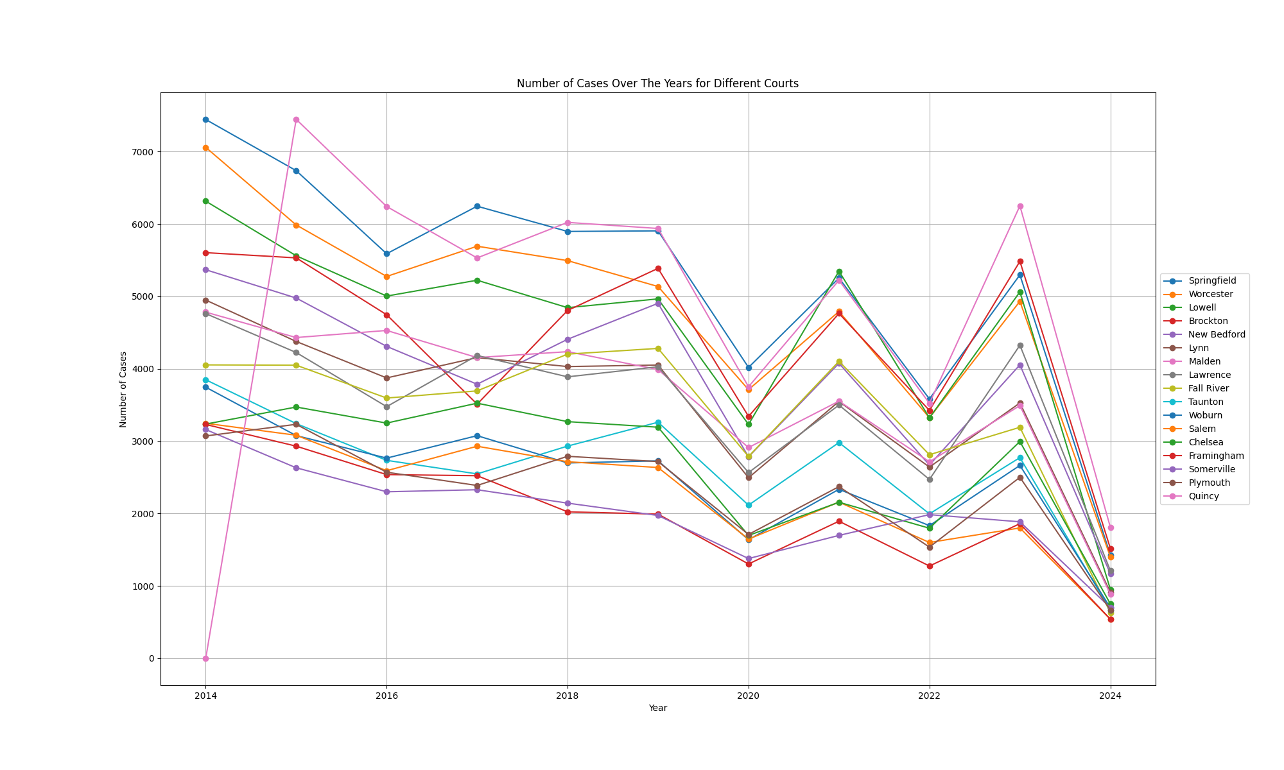
TOTAL number of Cases by District
Representing the number of debt case by District
Quincy has held the most number of cases in 2015 and has consistently held one of the top positions in the most amount of cases per year.
Note:
2024 Data is not complete
Graph only represents Courts with an average number of cases greater than 2000.

Slide 5
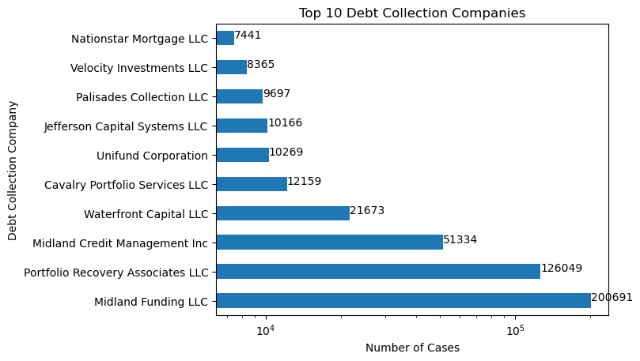
Debt collection companies
Debt Collectors (licensed 2017-2023)
774 companies licenced in MA
191 companies filing in courts
>484,815 debt collection cases
>9.87% of all filings in MA courts
Notes:
No company shown is in MA. First is Harvard Funding LLC operating out of Worcester, MA with 1561 cases.

Slide 6
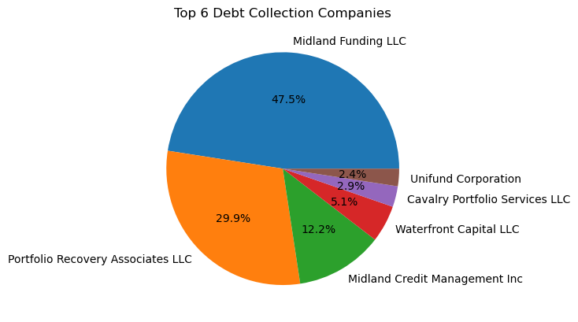
Debt collection companies
Most companies operate outside of Massachusetts
Midland Funding LLC - 47.5% (200,691) Birmingham, AL
Portfolio Recovery Associates LLC - 29.9% (126,049) Norfolk, VA
Midland Credit Management - 12.2% (51,334) San Diego, CA
Waterfront Capital LLC - 5.1% (21,673) Goffstown, NH
Cavalry Portfolio Services LLC - 2.9% (12,159) Greenwich, CT
Unifund Corp - 2.4% (10,269) Blue Ash, OH
(locations according to BBB)
Based on percent of cases handled by the company out of all debt collection cases

Slide 7
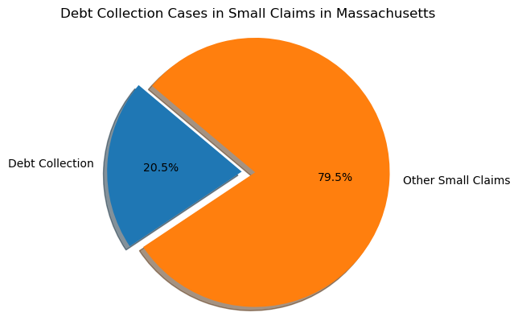
small claims and district court
Using compiled list of all know debt collectors operating in Massachusetts:
1,600,000 cases in small claims
almost 10,000 more cases than last month
326,996 debt collection cases as of April 8th
>20.47% of small claims court
Assumes all debt collection companies do is debt collection

Slide 8
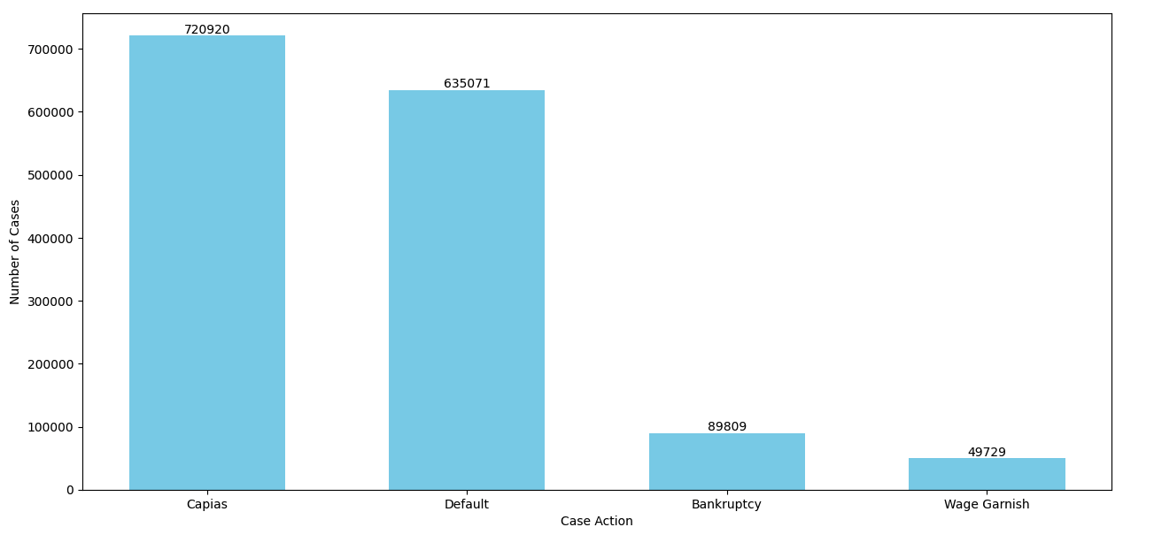
Counts of Special CASES
Number of capias cases: 720,920
Number of default cases: 635,071
Number of bankruptcy cases: 89,809
Number wage garnish cases: 49,729

Slide 9
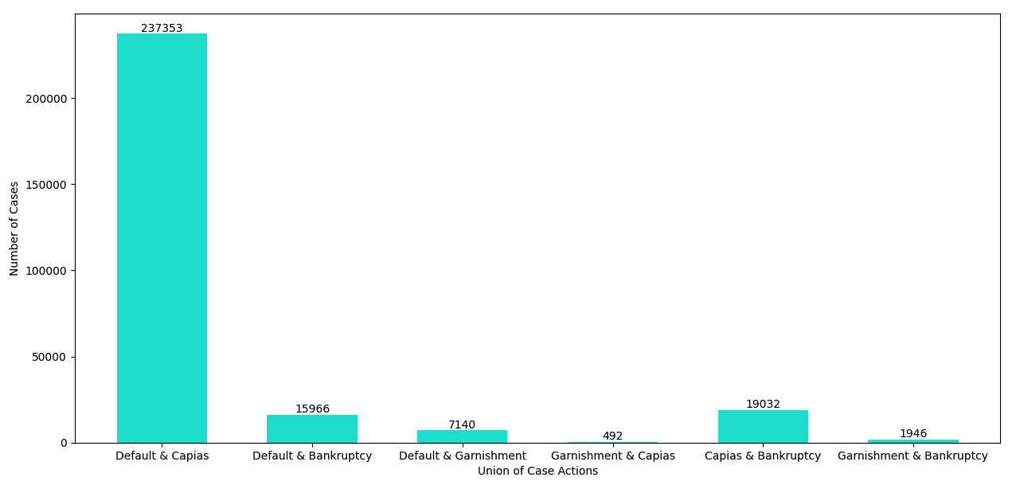
COMBINATION of SHARED CASES
Number of common cases between:
default and capias: 237,353
default and bankruptcy: 15,966
default and wage garnishment: 7,140
wage garnishment and capias: 492
capias and bankruptcy: 19,032
wage garnishment and bankruptcy: 1,946

Slide 10
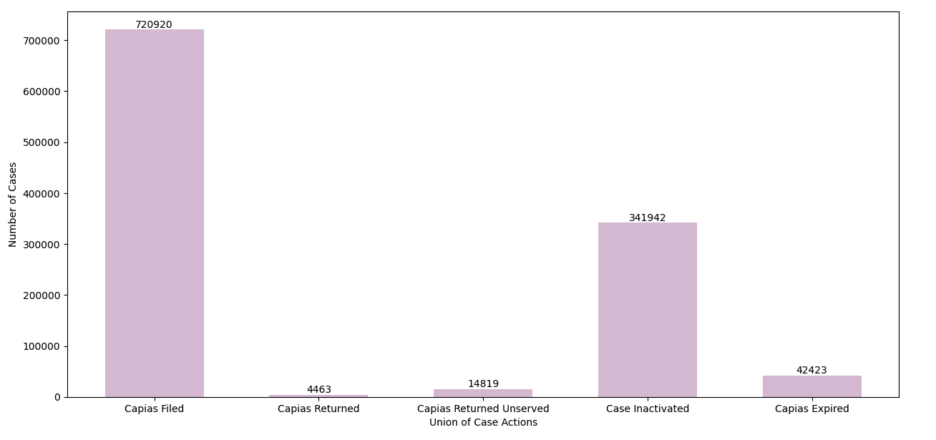
ANALYSIS OF CAPIAS CASES
Number of capias filed: 720,920
Number of capias returned: 4,463
Number of capias returned unserved: 14,819
Number of case inactivations: 341,942
Number of capias expired: 42,423

Slide 11
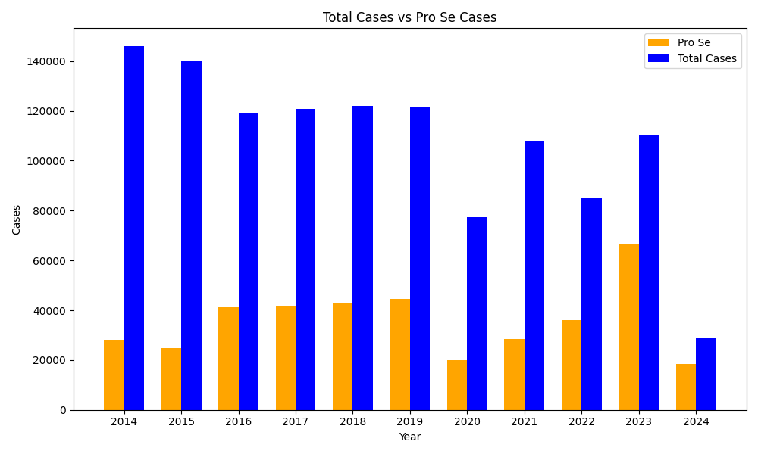
PRo SE VS TOTAL CASES
Representing all the cases per year and comparing them to the Pro Se cases of that year
Over the last decade there has been a total of 393,817 pro se cases and counting.
The most Pro Se cases was in 2023 at: 66,846 cases
Note: 2024 Data is not complete

Slide 12
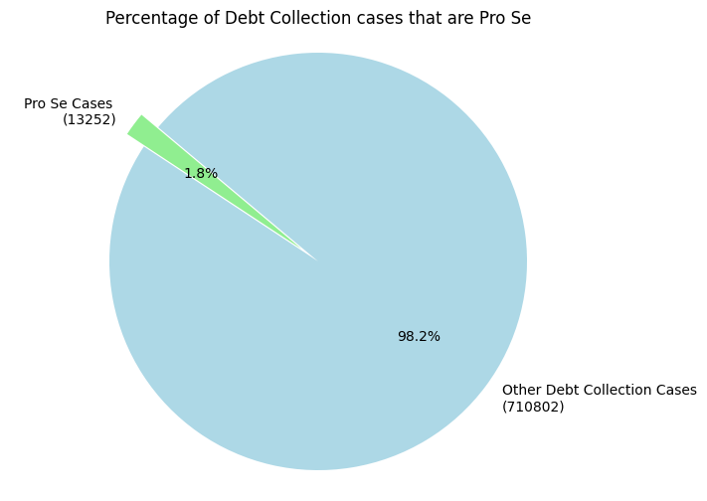
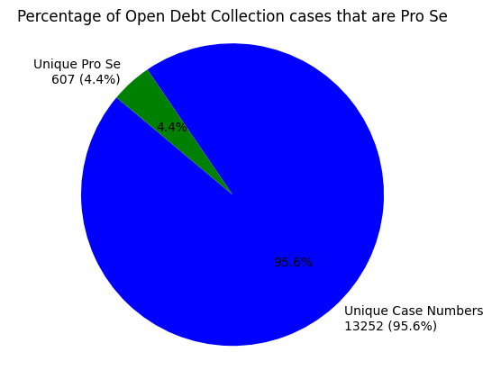
PRo SE Debt collection cases
There are currently 145,102 total Pro Se cases that are related to debt collection with 607 cases that are still open.

Slide 13
Future steps
How do special outcome cases influence the debt collection court process?
What is the debt range for which special cases happen?
Location
Special cases connected
What are some new trends found in debt collection cases?
Possibilities
Specific amount of money targeted
Debt source

Slide 14
Blockers
Any specific topics we should look at not mentioned?
Any additional data wanted in the report not included here?

Slide 15

Thank you!

